Slide 1
Automation and Control Laboratory
Inverted Pendulum Control
FRANCESCO CERESETTI - ALESSANDRO COLOMBO – GIACOMO DELCARO – PAOLO FUSCO

Slide 2
System Description
Text here
wagergwg

Slide 3
MODEL
EQUATIONS

Slide 4
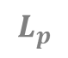
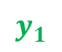
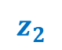
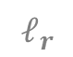
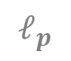

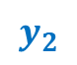

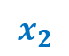
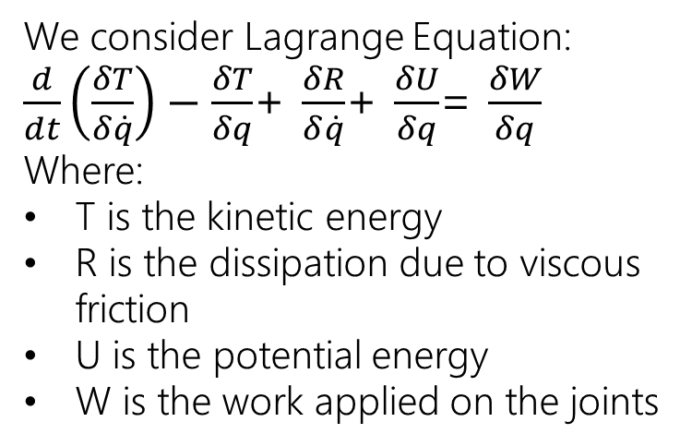
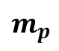

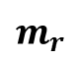
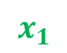
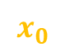
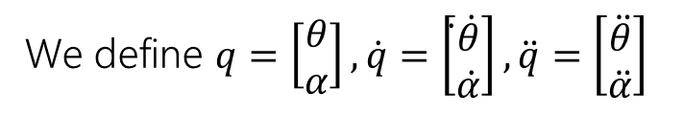


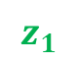
Model equations
$$L_{r}$$
$$z_{1}$$
We consider Lagrange Equation:
$\frac{d}{dt}\left(\frac{δT}{δ\dot{q}}\right)−\frac{δT}{δq}$+ $\frac{δR}{δ\dot{q}}$+ $\frac{δU}{δq}$= $\frac{δW}{δq}$
Where:
T is the kinetic energy
R is the dissipation due to viscous friction
U is the potential energy
W is the work applied on the joints
$$ℓ_{r}$$
$$m_{r}$$
$$z_{0}$$
$$x_{1}$$
ROD
$$y_{1}$$
$$ℓ_{p}$$
$$θ$$
$$y_{0}$$
$$L_{p}$$
$$x_{0}$$
$$m_{p}$$
PENDULUM
We define $q=\left[\begin{aligned}θ \\ α\end{aligned}\right],\dot{q}=\left[\begin{aligned}̇\dot{θ} \\ \dot{α}\end{aligned}\right],\ddot{q}=\left[\begin{aligned}\ddot{θ} \\ \ddot{α}\end{aligned}\right]$
$$α$$
$$x_{2}$$
$$y_{2}$$
$$z_{2}$$

Slide 5
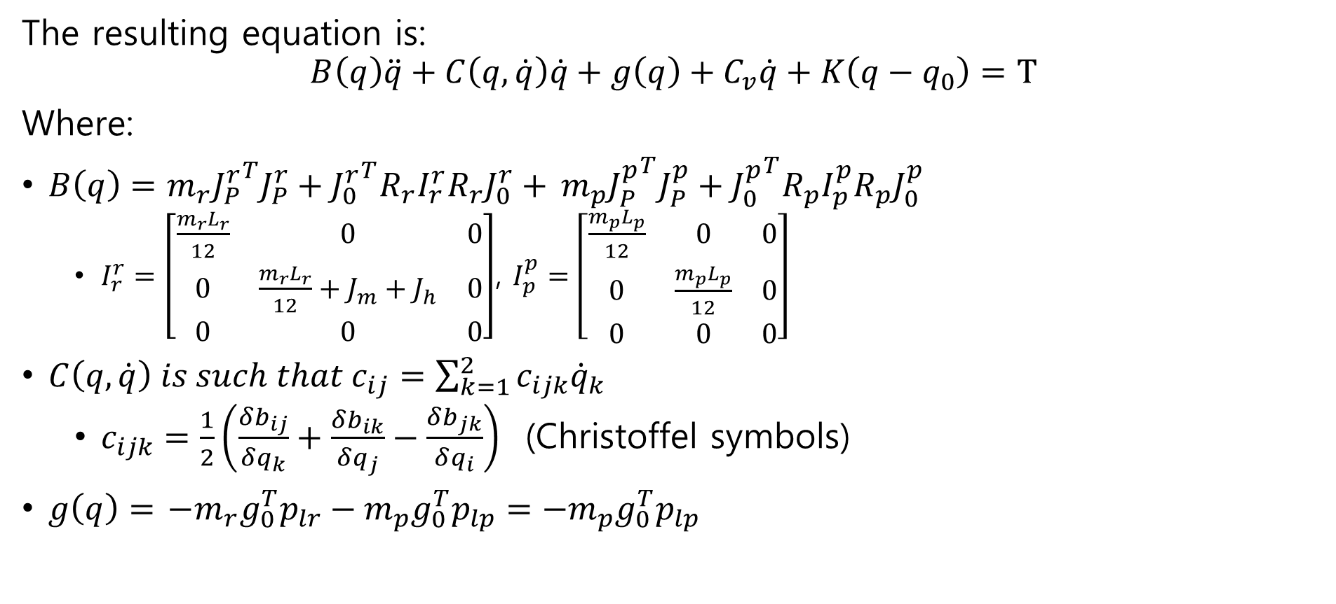
Model equations
The resulting equation is:
$$B\left(q\right)\ddot{q}+C\left(q,\dot{q}\right)\dot{q}+g\left(q\right)+C_{v}\dot{q}+K\left(q−q_{0}\right)=T$$
Where:
$B\left(q\right)=m_{r}{J_{P}^{r}}^{T}J_{P}^{r}+{J_{0}^{r}}^{T}R_{r}I_{r}^{r}R_{r}J_{0}^{r}+$ $m_{p}{J_{P}^{p}}^{T}J_{P}^{p}+{J_{0}^{p}}^{T}R_{p}I_{p}^{p}R_{p}J_{0}^{p}$
$I_{r}^{r}=\left[\begin{matrix}\frac{m_{r}L_{r}}{12} & 0 & 0 \\ 0 & \frac{m_{r}L_{r}}{12}+J_{m}+J_{h} & 0 \\ 0 & 0 & 0\end{matrix}\right]$, $I_{p}^{p}=\left[\begin{matrix}\frac{m_{p}L_{p}}{12} & 0 & 0 \\ 0 & \frac{m_{p}L_{p}}{12} & 0 \\ 0 & 0 & 0\end{matrix}\right]$
$C\left(q,\dot{q}\right) is such that c_{ij}=\sum_{k=1}^{2}{c_{ijk}{\dot{q}}_{k}}$
$c_{ijk}=\frac{1}{2}\left(\frac{δb_{ij}}{δq_{k}}+\frac{δb_{ik}}{δq_{j}}−\frac{δb_{jk}}{δq_{i}}\right)$ (Christoffel symbols)
$g\left(q\right)=$ $−m_{r}g_{0}^{T}p_{lr}−m_{p}g_{0}^{T}p_{lp}=−m_{p}g_{0}^{T}p_{lp}$

Slide 6
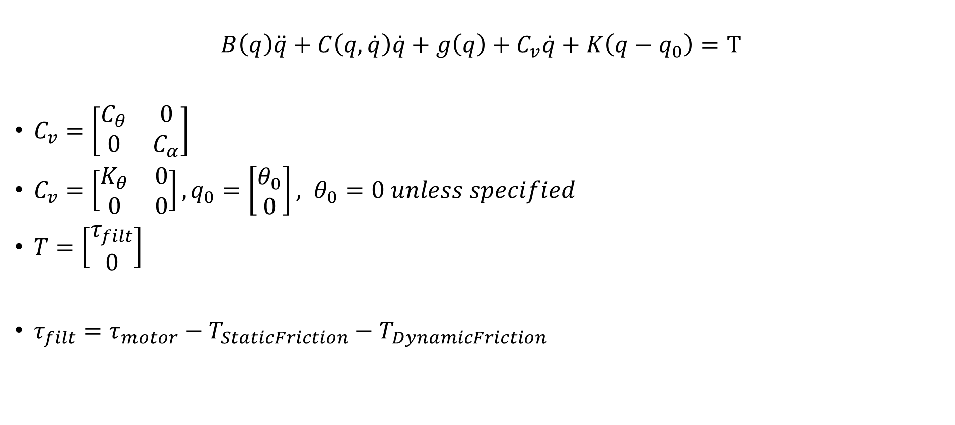
Model equations
$$B\left(q\right)\ddot{q}+C\left(q,\dot{q}\right)\dot{q}+g\left(q\right)+C_{v}\dot{q}+K\left(q−q_{0}\right)=T$$
$C_{v}=\left[\begin{matrix}C_{θ} & 0 \\ 0 & C_{α}\end{matrix}\right]$
$C_{v}=\left[\begin{matrix}K_{θ} & 0 \\ 0 & 0\end{matrix}\right], q_{0}=\left[\begin{aligned}θ_{0} \\ 0\end{aligned}\right], θ_{0}=0 unless specified$
$T=\left[\begin{aligned}τ_{filt} \\ 0\end{aligned}\right]$
$τ_{filt}=τ_{motor}−T_{StaticFriction}−T_{DynamicFriction}$

Slide 7
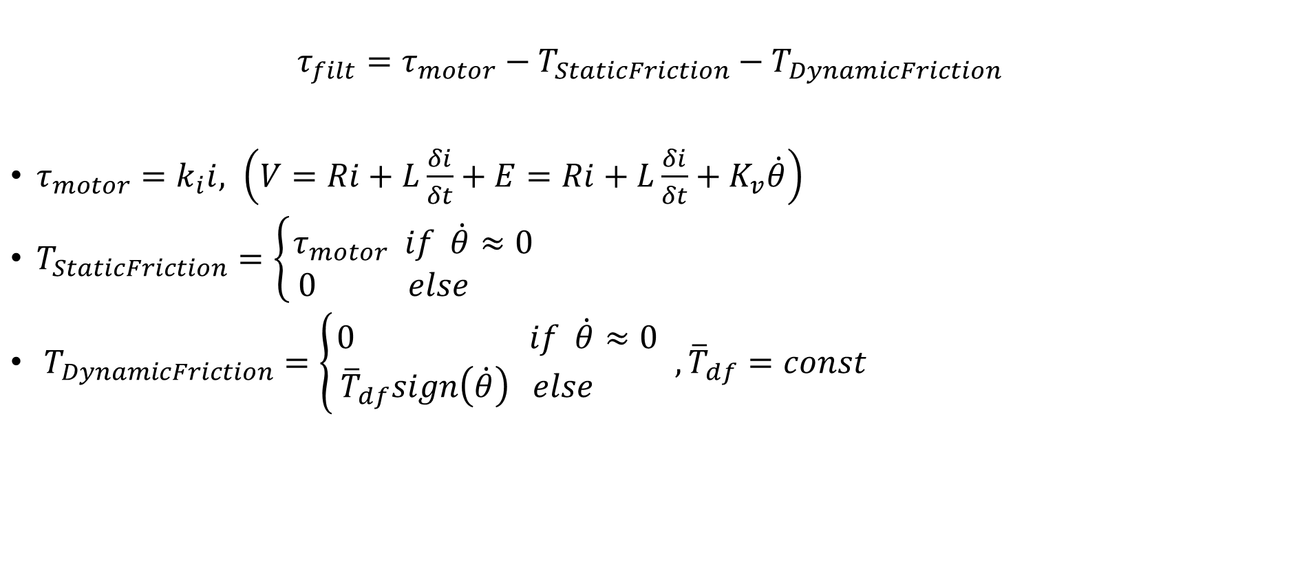
Model equations
$$τ_{filt}=τ_{motor}−T_{StaticFriction}−T_{DynamicFriction}$$
$τ_{motor}=k_{i}i, \left(V=Ri+L\frac{δi}{δt}+E=Ri+L\frac{δi}{δt}+K_{v}\dot{θ}\right)$
$T_{StaticFriction}=\left\{\begin{aligned}τ_{motor} if \dot{θ}≈0 \\ 0 else \end{aligned}\right.$
$T_{DynamicFriction}=\left\{\begin{aligned}0 if \dot{θ}≈0 \\ {\overline{T}}_{df}sign\left(\dot{θ}\right) else \end{aligned}\right.,{\overline{T}}_{df}=const$

Slide 8
SYSTEM IDENTIFICATION

Slide 9
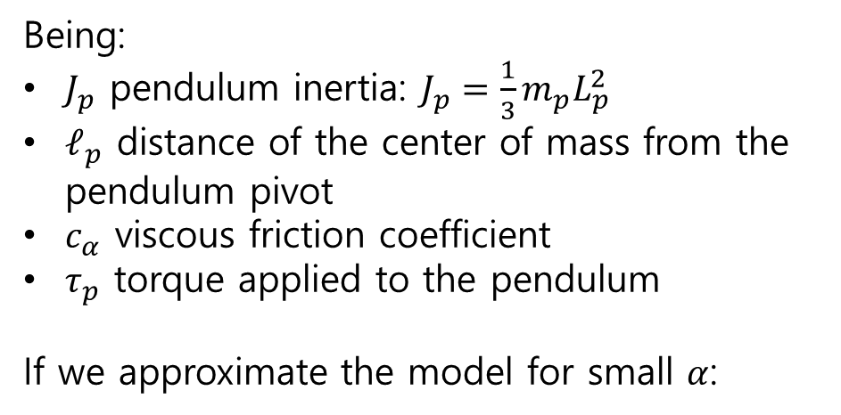
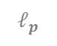
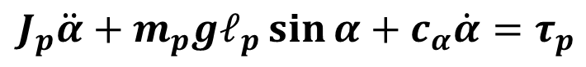
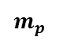
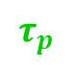

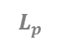
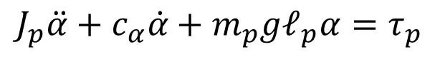
Pendulum Model
We will start with the pendulum parameters identification.
If we consider a system only made by the pendulum, the dynamic relations can be written as:
$$J_{p}\ddot{α}+m_{p}gℓ_{p}\sin{α}+c_{α}\dot{α}=τ_{p}$$
$$τ_{p}$$
$$ℓ_{p}$$
Being:
$J_{p}$ pendulum inertia: $J_{p}=\frac{1}{3}m_{p}L_{p}^{2}$
$ℓ_{p}$ distance of the center of mass from the pendulum pivot
$c_{α}$ viscous friction coefficient
$τ_{p}$ torque applied to the pendulum
If we approximate the model for small $α$:
$$L_{p}$$
$$m_{p}$$
PENDULUM
$$α$$
$$J_{p}\ddot{α}+{c_{α}\dot{α}+m}_{p}gℓ_{p}α=τ_{p}$$

Slide 10
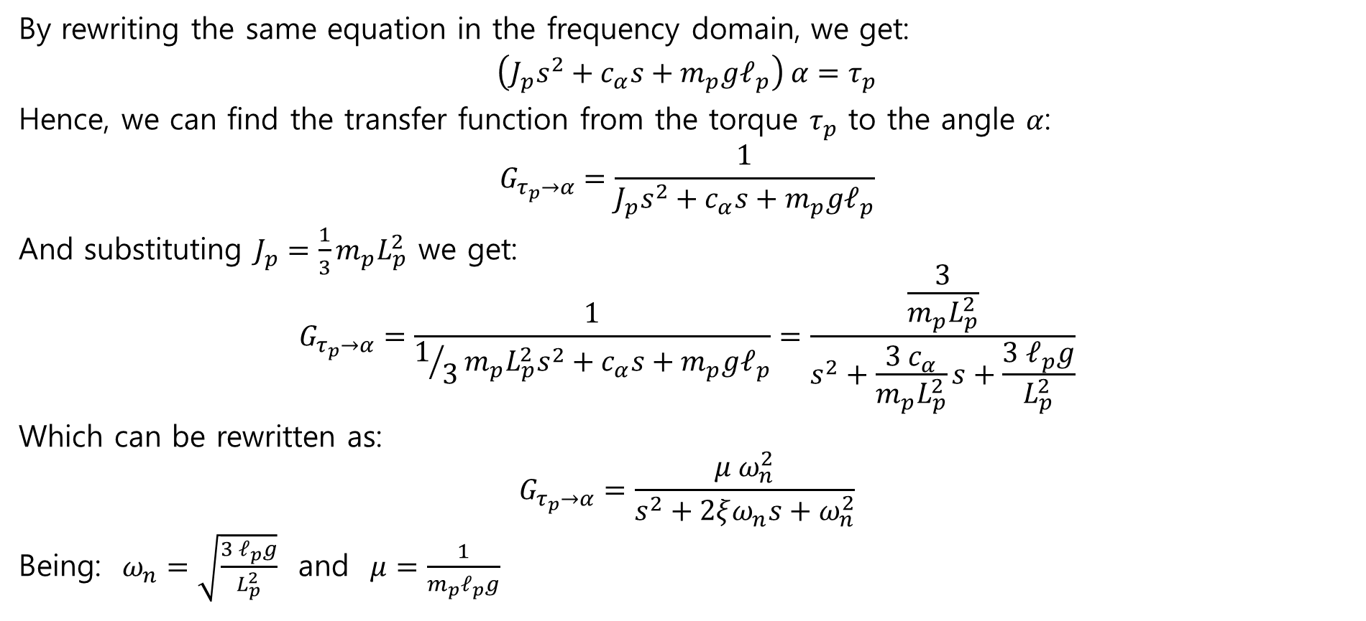
Pendulum Model
By rewriting the same equation in the frequency domain, we get:
$$\left(J_{p}s^{2}+{c_{α}s+m}_{p}gℓ_{p}\right) α=τ_{p}$$
Hence, we can find the transfer function from the torque $τ_{p}$ to the angle $α$:
$$G_{τ_{p}→α}=\frac{1}{J_{p}s^{2}+{c_{α}s+m}_{p}gℓ_{p}}$$
And substituting $J_{p}=\frac{1}{3}m_{p}L_{p}^{2}$ we get:
$$G_{τ_{p}→α}=\frac{1}{1/3m_{p}L_{p}^{2}s^{2}+{c_{α}s+m}_{p}gℓ_{p}}=\frac{\frac{3}{m_{p}L_{p}^{2}}}{s^{2}+\frac{3 c_{α}}{m_{p}L_{p}^{2}}s+\frac{3{ ℓ}_{p}g}{L_{p}^{2}}}$$
Which can be rewritten as:
$$G_{τ_{p}→α}=\frac{μ ω_{n}^{2}}{s^{2}+2ξω_{n}s+ω_{n}^{2}}$$
Being: $ω_{n}=\sqrt{\frac{3{ ℓ}_{p}g}{L_{p}^{2}}}$ and $μ=\frac{1}{m_{p}ℓ_{p}g}$

Slide 11
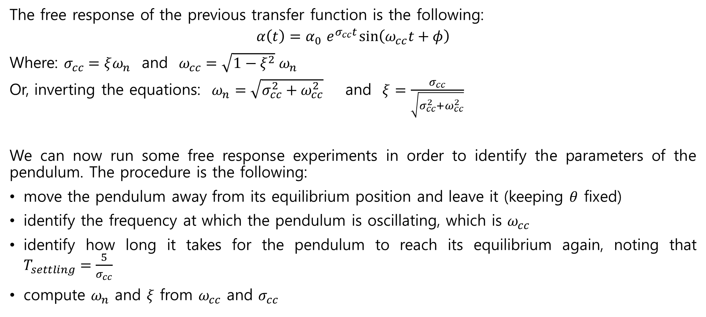
Pendulum Model
The free response of the previous transfer function is the following:
$$α\left(t\right)=α_{0}{ e}^{σ_{cc}t}\sin\left(ω_{cc}t+φ\right)$$
Where: $σ_{cc}=ξω_{n}$ and $ω_{cc}=\sqrt{1−ξ^{2}} ω_{n}$
Or, inverting the equations: $ω_{n}=\sqrt{σ_{cc}^{2}+ω_{cc}^{2}}$ and $ξ=\frac{σ_{cc}}{\sqrt{σ_{cc}^{2}+ω_{cc}^{2}}}$
We can now run some free response experiments in order to identify the parameters of the pendulum. The procedure is the following:
move the pendulum away from its equilibrium position and leave it (keeping $θ$ fixed)
identify the frequency at which the pendulum is oscillating, which is $ω_{cc}$
identify how long it takes for the pendulum to reach its equilibrium again, noting that $T_{settling}=\frac{5}{σ_{cc}}$
compute $ω_{n}$ and $ξ$ from $ω_{cc}$ and $σ_{cc}$

Slide 12
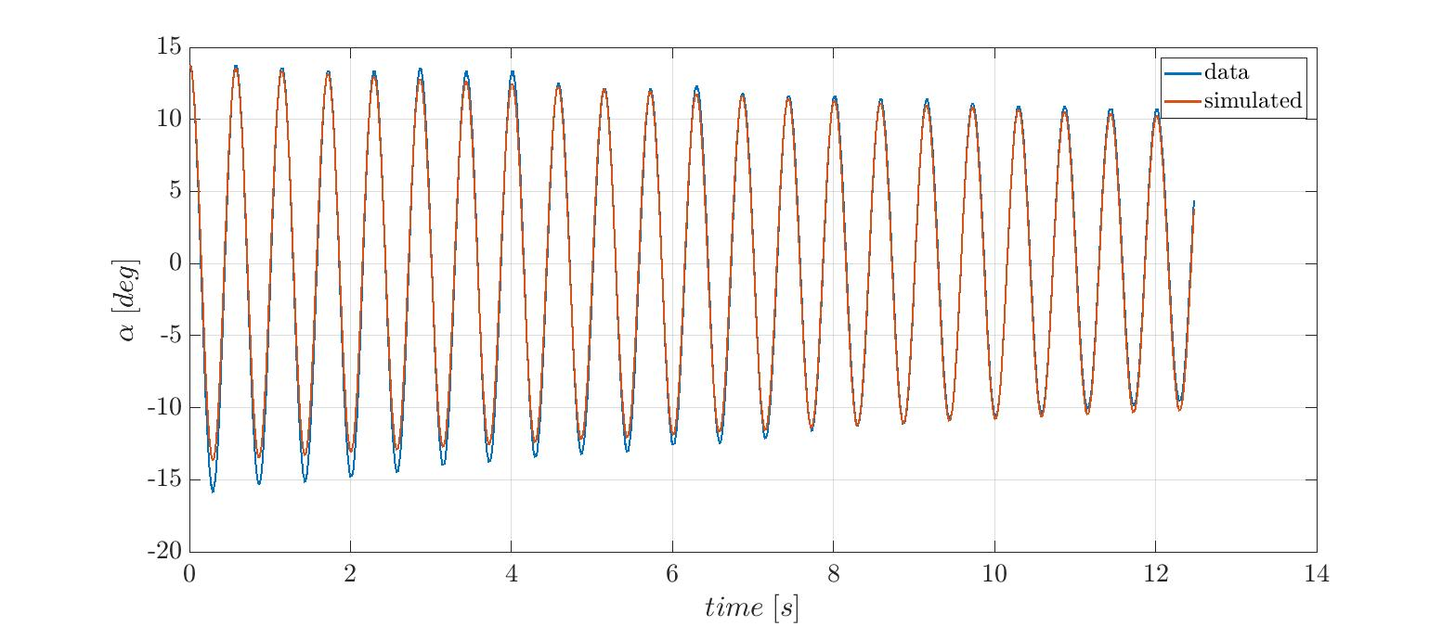
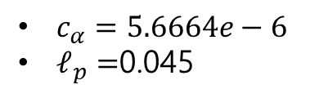
Pendulum Model
compute $c_{α}=\frac{2}{3}{ξω_{n}m}_{p}L_{p}^{2}$
compute $ℓ_{p}=\frac{L_{p}^{2} ω_{n}}{3g}$
$c_{α}=5.6664e−6$
$ℓ_{p}=$0.045

Slide 13
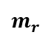
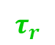
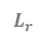

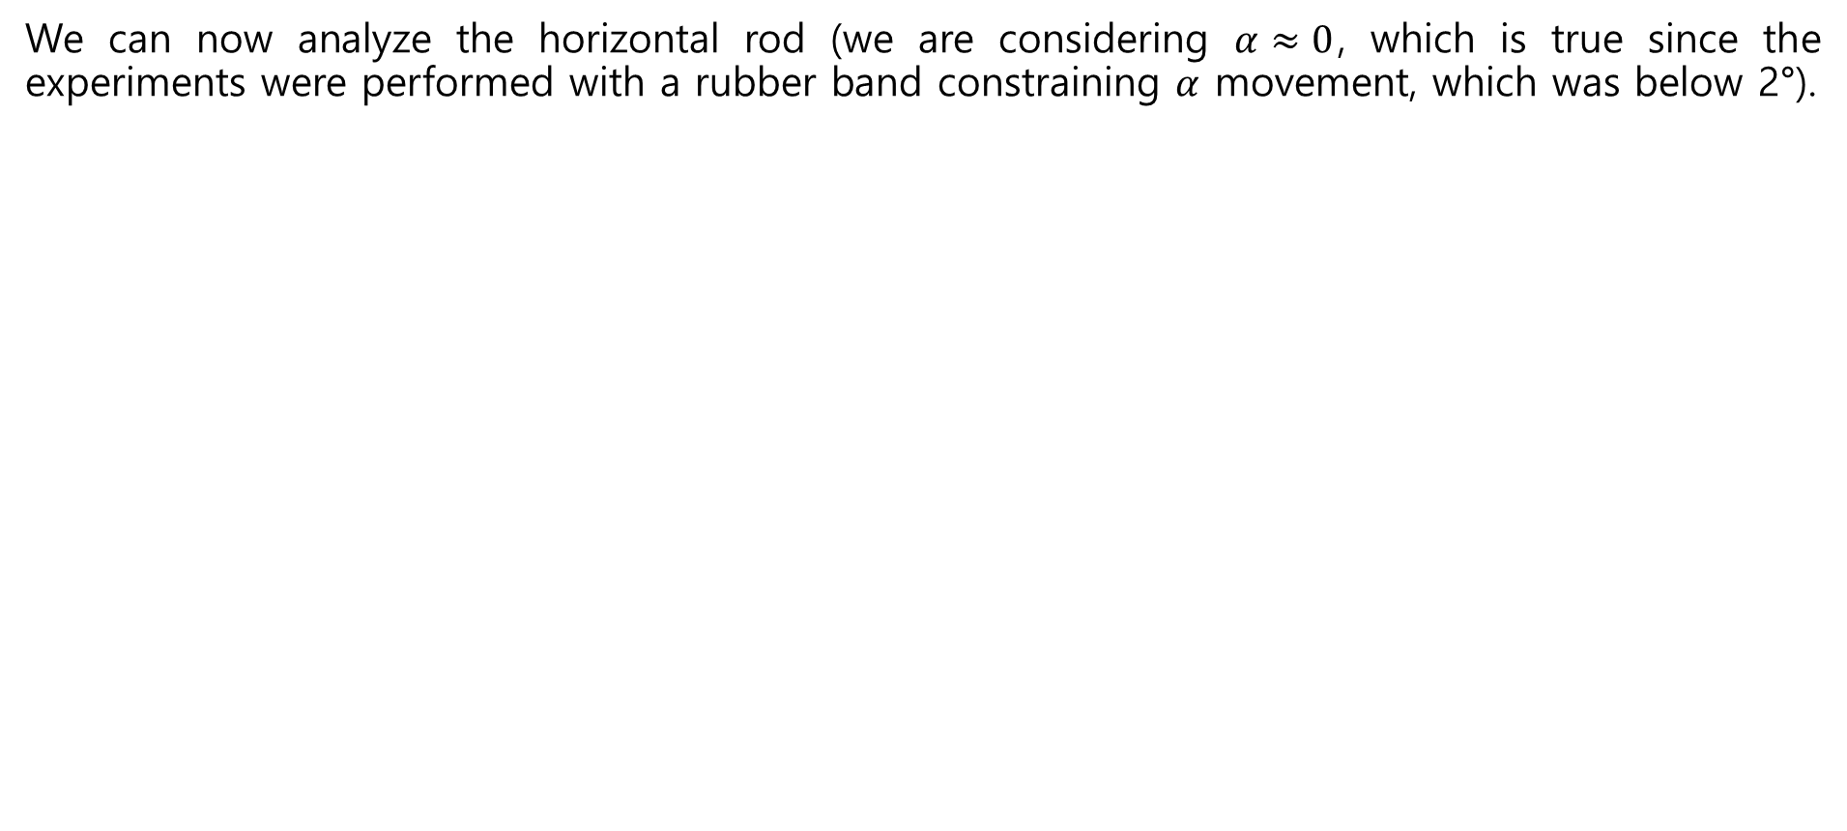
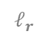
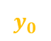

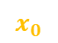
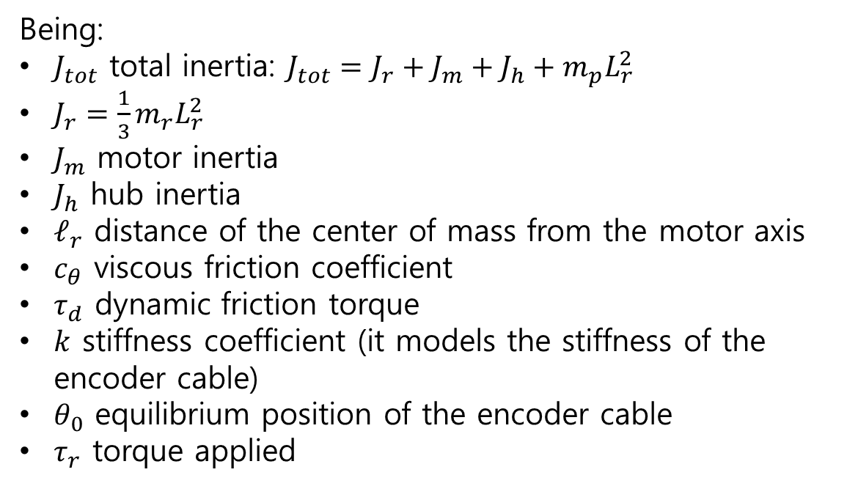
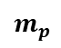
Horizontal Rod Model
We can now analyze the horizontal rod (we are considering $α≈0$, which is true since the experiments were performed with a rubber band constraining $α$ movement, which was below 2°).
$$J_{tot}\ddot{θ}+c_{θ}\dot{θ}+τ_{d}\operatorname{sign}{\dot{θ}}+k\left(θ−θ_{0}\right)=τ_{r}$$
Being:
$J_{tot}$ total inertia: $J_{tot}=J_{r}+J_{m}+J_{h}+m_{p}L_{r}^{2}$
$J_{r}=\frac{1}{3}m_{r}L_{r}^{2}$
$J_{m}$ motor inertia
$J_{h}$ hub inertia
$ℓ_{r}$ distance of the center of mass from the motor axis
$c_{θ}$ viscous friction coefficient
$τ_{d}$ dynamic friction torque
$k$ stiffness coefficient (it models the stiffness of the encoder cable)
$θ_{0}$ equilibrium position of the encoder cable
$τ_{r}$ torque applied
$$L_{r}$$
$$m_{p}$$
$$ℓ_{r}$$
$$m_{r}$$
$$z_{0}$$
ROD
$$θ$$
$$y_{0}$$
$$x_{0}$$
$$τ_{r}$$

Slide 14
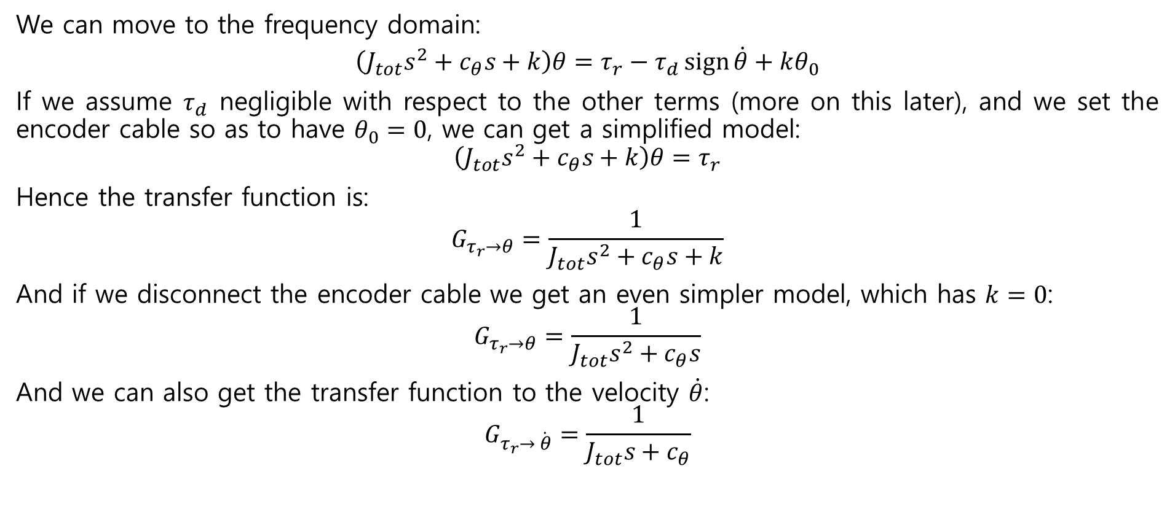
Horizontal Rod Model
We can move to the frequency domain:
$$\left(J_{tot}s^{2}+c_{θ}s+k\right)θ=τ_{r}−τ_{d}\operatorname{sign}{\dot{θ}}+kθ_{0}$$
If we assume $τ_{d}$ negligible with respect to the other terms (more on this later), and we set the encoder cable so as to have $θ_{0}=0$, we can get a simplified model:
$$\left(J_{tot}s^{2}+c_{θ}s+k\right)θ=τ_{r}$$
Hence the transfer function is:
$$G_{τ_{r}→θ}=\frac{1}{J_{tot}s^{2}+c_{θ}s+k}$$
And if we disconnect the encoder cable we get an even simpler model, which has $k=0$:
$$G_{τ_{r}→θ}=\frac{1}{J_{tot}s^{2}+c_{θ}s}$$
And we can also get the transfer function to the velocity $\dot{θ}$:
$$G_{τ_{r}→ \dot{θ}}=\frac{1}{J_{tot}s+c_{θ}}$$

Slide 15
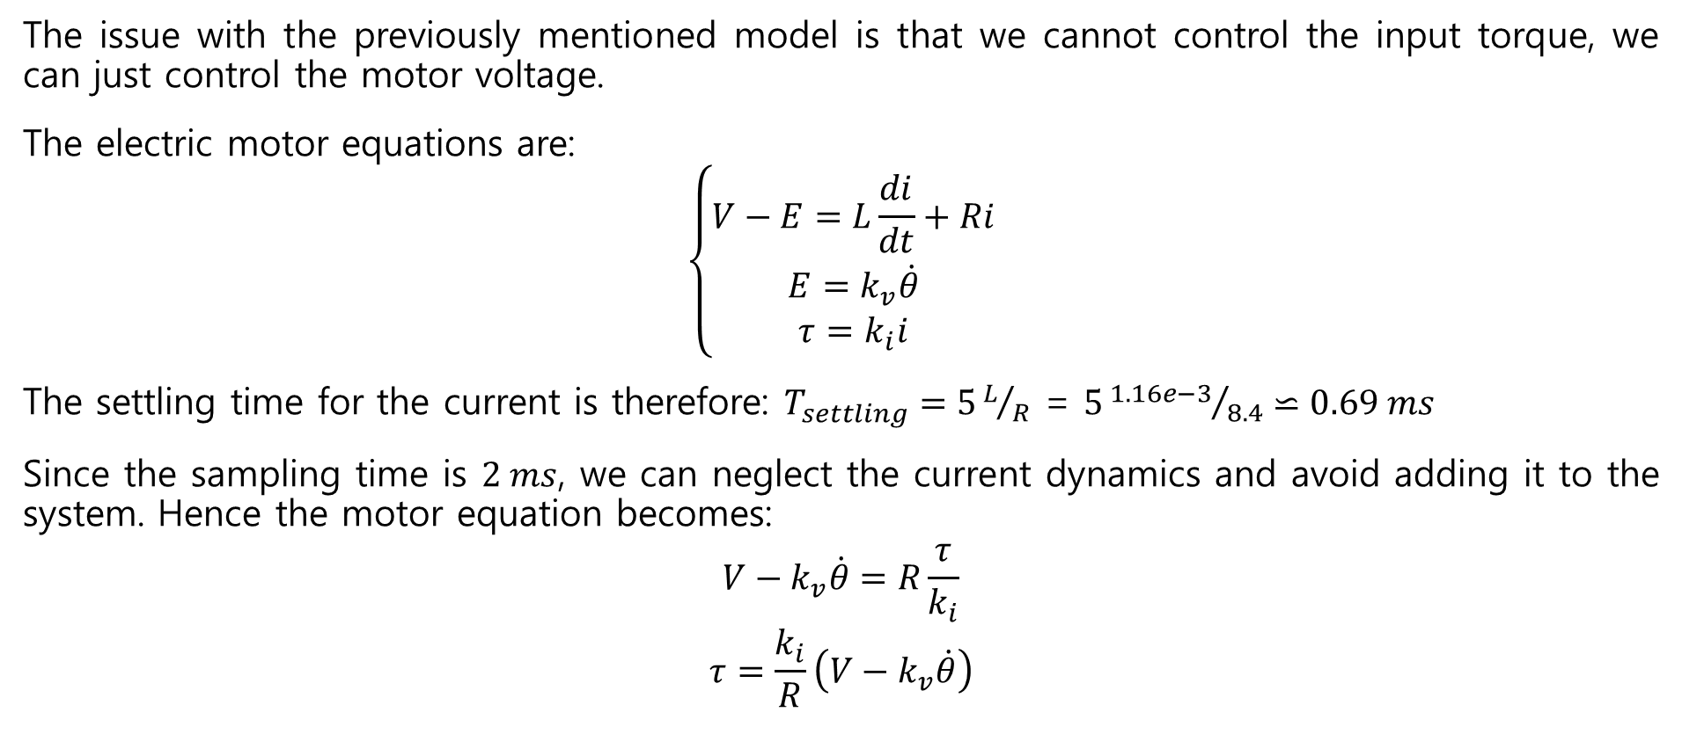
Horizontal Rod Model
The issue with the previously mentioned model is that we cannot control the input torque, we can just control the motor voltage.
The electric motor equations are:
$$\left\{\begin{matrix}V−E=L\frac{di}{dt}+Ri \\ E=k_{v}\dot{θ} \\ τ=k_{i}i\end{matrix}\right.$$
The settling time for the current is therefore: $T_{settling}=5L/R$ = $5{1.16e−3}/{8.4}⋍0.69 ms$
Since the sampling time is $2 ms$, we can neglect the current dynamics and avoid adding it to the system. Hence the motor equation becomes:
$$V−k_{v}\dot{θ}=R\frac{τ}{k_{i}}$$
$$τ=\frac{k_{i}}{R}\left(V−k_{v}\dot{θ}\right)$$

Slide 16
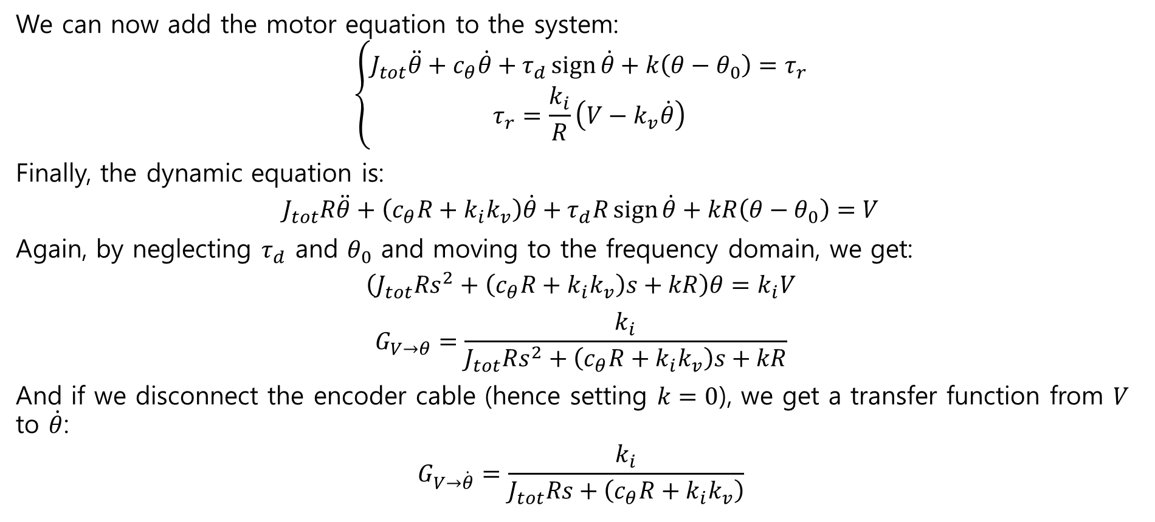
Horizontal Rod Model
We can now add the motor equation to the system:
$$\left\{\begin{matrix}J_{tot}\ddot{θ}+c_{θ}\dot{θ}+τ_{d}\operatorname{sign}{\dot{θ}}+k\left(θ−θ_{0}\right)=τ_{r} \\ τ_{r}=\frac{k_{i}}{R}\left(V−k_{v}\dot{θ}\right)\end{matrix}\right.$$
Finally, the dynamic equation is:
$$J_{tot}R\ddot{θ}+\left(c_{θ}R+k_{i}k_{v}\right)\dot{θ}+τ_{d}R\operatorname{sign}{\dot{θ}}+kR\left(θ−θ_{0}\right)=V$$
Again, by neglecting $τ_{d}$ and $θ_{0}$ and moving to the frequency domain, we get:
$$\left(J_{tot}Rs^{2}+\left(c_{θ}R+k_{i}k_{v}\right)s+kR\right)θ=k_{i}V$$
$$G_{V→θ}=\frac{k_{i}}{J_{tot}Rs^{2}+\left(c_{θ}R+k_{i}k_{v}\right)s+kR}$$
And if we disconnect the encoder cable (hence setting $k=0$), we get a transfer function from $V$ to $\dot{θ}$:
$$G_{V→\dot{θ}}=\frac{k_{i}}{J_{tot}Rs+\left(c_{θ}R+k_{i}k_{v}\right)}$$

Slide 17
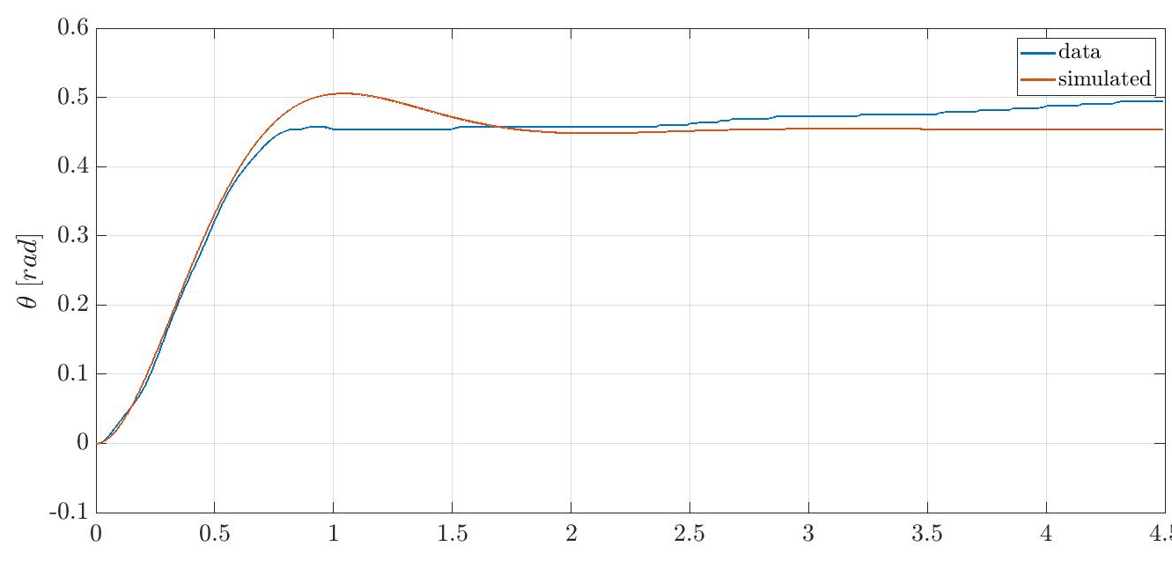
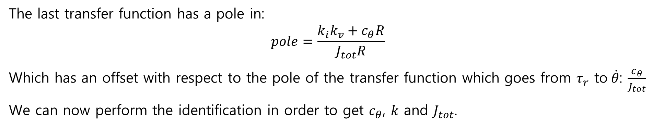
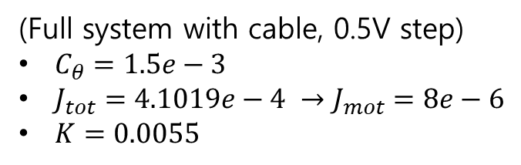
Horizontal Rod Model
The last transfer function has a pole in:
$$pole=\frac{k_{i}k_{v}+c_{θ}R}{J_{tot}R}$$
Which has an offset with respect to the pole of the transfer function which goes from $τ_{r}$ to$\dot{θ}$: $\frac{c_{θ}}{J_{tot}}$
We can now perform the identification in order to get $c_{θ}$, $k$ and $J_{tot}$.
(Full system with cable, 0.5V step)
$C_{θ}=1.5e−3$
$J_{tot}=4.1019e−4 →J_{mot}=8e−6$
$K=0.0055$

Slide 18
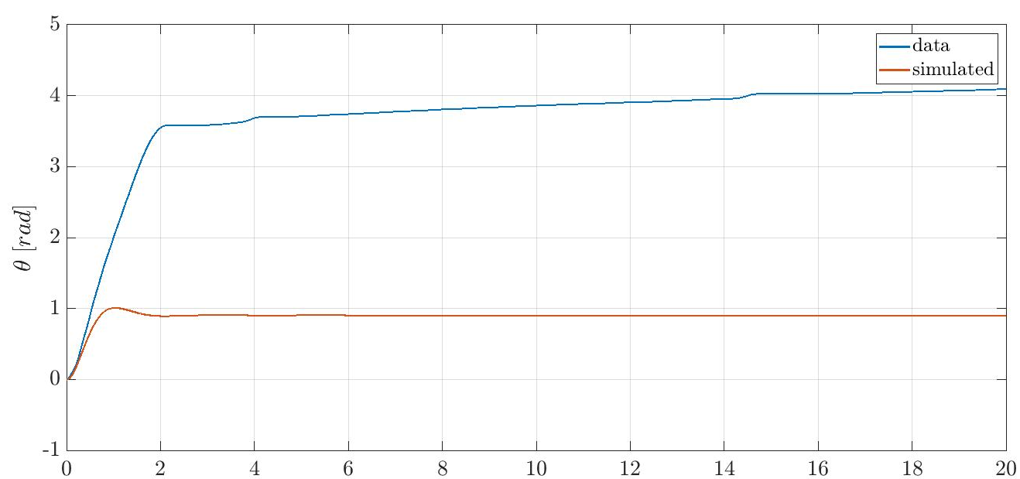
Horizontal Rod Model
However note that the ‘spring’ has a very nonlinear behaviour, in fact, when validating on a 1V step experiment, we obtain this:

Slide 19
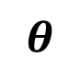

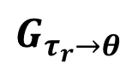
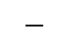
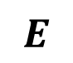
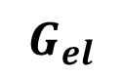
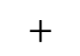





Horizontal Rod Model
Notice that the last model we obtained is assuming that the current dynamics do not affect the system. This can be also proven by computing the complete model according to the following scheme:
$$V$$
$$+$$
$$τ$$
$$θ$$
$$G_{el}$$
$$G_{τ_{r}→θ}$$
$$−$$
$$\dot{θ}$$
$$E$$
$$s$$
$$k_{v}$$
Where:
$$G_{τ_{r}→θ}=\frac{1}{J_{tot}s^{2}+c_{θ}s+k}$$
and
$$G_{el}=\frac{k_{i}}{sL+R}$$

Slide 20



Horizontal Rod Model
Hence, the system has a transfer function given by:
$$G_{V→θ}=\frac{G_{el}G_{τ_{r}→θ}}{1+{sk}_{v}G_{el}G_{τ_{r}→θ}}=\frac{1}{\frac{1}{G_{el}G_{τ_{r}→θ}}+{sk}_{v}}$$
And replacing the expressions we get:
$$G_{V→θ}=\frac{k_{i}}{J_{tot}L{ s}^{3}+\left(J_{tot}R+c_{θ}L\right)s^{2}+\left(Lk+c_{θ}R+k_{i}k_{v}\right)s+Rk}=$$
$$=\frac{R}{sL+R} \frac{\frac{k_{i}}{R}}{\left(J_{tot}s^{2}+c_{θ}s+k\right)+s\frac{k_{i}k_{v}}{R} \frac{R}{sL+R}}≈$$
$$≈\frac{k_{i}}{J_{tot}Rs^{2}+\left(c_{θ}R+k_{i}k_{v}\right)s+kR}$$
We got the same equation as before.
$$≈1$$
$$≈1$$

Slide 21












Static Friction Identification
We now want to add static friction to the model.
As previously mentioned, we can synthetize the model as follows:
Where $G_{el}=\frac{k_{i}}{sL+R}$ , so we can compute $τ$ by measuring $V$ as: ${τ=G}_{el}\left(V−k_{v}\dot{θ}\right)$, where $\dot{θ}$ can be computed offline.
In order to identify the static friction, we can increase gradually $V$ up to the moment in which $θ$ starts moving. Then we know the value of $τ_{r}$ such that, if $τ_{r}<τ_{threshold}$ we have no movement in $θ$. $τ_{threshold}$ is the value of the static friction we are looking for.
By repeating the experiment four times, we get $τ_{threshold}=7.9 {10}^{−4} Nm$
Finally, we can set the dynamic friction torque as $0.85∙τ_{threshold}$
$$V$$
$$+$$
$$τ$$
$$G_{el}$$
$$G_{τ_{r}→θ}$$
$$θ$$
$$−$$
$$E$$
$$s$$
$$\dot{θ}$$
$$k_{v}$$

Slide 22

Complete System Optimization
Finally, let us consider the overall system.
We cannot easily identify the parameters on the overall system, hence we will write the problem as an optimization problem and run a suitable optimizer so as to solve the problem.
PROBLEM STATEMENT:
$$\min_{k_{i} ∈ K}\left(a_{θ}∙\operatorname{rms}\left(θ−\hat{θ}\right)+a_{\dot{θ}}∙\operatorname{rms}\left(\dot{θ}−\hat{\dot{θ}}\right)+a_{α}∙\operatorname{rms}\left(α−\hat{α}\right)+a_{\dot{α}}∙\operatorname{rms}\left(\dot{ α}−\hat{\dot{α}}\right)\right)$$
Where $k_{i}$ is a parameter to be tuned, which has some optimization limits defined in $K$.
All the variables with a “hat” are the outputs of a full-fledged simulator (see later). Therefore, in the cost function we are weighting the difference between the real and the simulated data, multiplied for some weighting coefficients.

Slide 23


Complete System Optimization – Fast Dynamics
The first optimization is performed in order to optimize the fast dynamics of the system, which are given mostly by the viscous friction and inertias of the system.
The first set of parameters to be optimized is therefore $ℓ_{p},ℓ_{r}, c_{θ}, c_{α}$.
The chosen range for the optimization is $\left[0.5 1.5\right]∙k_{i_{nominal value}}$ for each optimization variable.
The weights which were used in this optimization were: $a_{θ}=0, a_{\dot{θ}}=0.5,$ $a_{α}=1, a_{\dot{α}}=0.05$
In particular $a_{θ}=0$ since $θ$ tends to drift over time, so we are only weighting its velocity (since the drift is a low frequency behavior caused by non-linearities of the encoder cable and friction).
The chosen dataset is a voltage sweep sine, so as to validate all frequencies.

Slide 24
Complete System Optimization – Fast Dynamics
Optimization run
The low frequency sinusoids are not that accurate, due to the presence of friction and non linearities (for example the encoder cable, modeled as a spring). At high frequency the simulator is quite accurate.

Slide 25


Complete System Optimization – Fast Dynamics

Slide 26


Complete System Optimization – Fast Dynamics
$θ$ has an offset, this is why we are only weighting its derivative
The simulated resonance is close to the real one (almost perfect results could be obtained by using datasets with smaller $α$, but they did not perform well for higher $α$ angles)

Slide 27

Complete System Optimization – Fast Dynamics
We can also take a look at the velocity profile in the resonance, which is quite accurate.

Slide 28


Complete System Optimization – Slow Dynamics
We can perform the same optimization also for the slow dynamics.
In particular, the optimization variables in this case are: $τ_{d}, τ_{static threshold}, k$
The chosen range for the optimization is $\left[0.5 1.5\right]∙k_{i_{nominal value}}$ for each optimization variable.
The weights which were used in this optimization were: $a_{θ}=1, a_{\dot{θ}}=1,$ $a_{α}=0, a_{\dot{α}}=0$ (we do not want to estimate correctly $α$ but just the slow dynamics of $θ$).
The selected dataset in this case was a sequence of steps and ramps (for the estimation of slow dynamics only the ramps are needed, but due to static friction non linearities also the steps were used, so as to obtain better overall performance. In any case, this optimization was run after the fast dynamics one).

Slide 29

Complete System Optimization – Slow Dynamics
The result is not that accurate due to the following facts:
the real behavior of the encoder cable cannot be approximated with a spring, since it depends on $θ$ and it is even asymmetric
The static friction depends on $θ$ (notice the difference in static friction in the first two steps with respect to the one in the first ramp)

Slide 30
SIMULATOR
DESIGN

Slide 31














Simulator
The simulator solves the previously mentioned dynamics.
(The mechanism for the saturation on $θ$ is not reported here)
$$\dot{θ}$$
$$\ddot{θ}$$
$$\frac{1}{s}$$
$$\dot{θ}$$
$$\frac{1}{s}$$
$$θ$$
$$V$$
Motor Model
$$τ$$
Acceleration Computation
$$\ddot{α}$$
$$\frac{1}{s}$$
$$\dot{α}$$
$$\frac{1}{s}$$
$$α$$

Slide 32
CONTROLLER
DESIGN

